Slide 1


Arquitectura de Computadores CC4301 Clase 6: Diseño Modular
Semestre Primavera 2013
Profesor: Pablo Guerrero

Slide 2
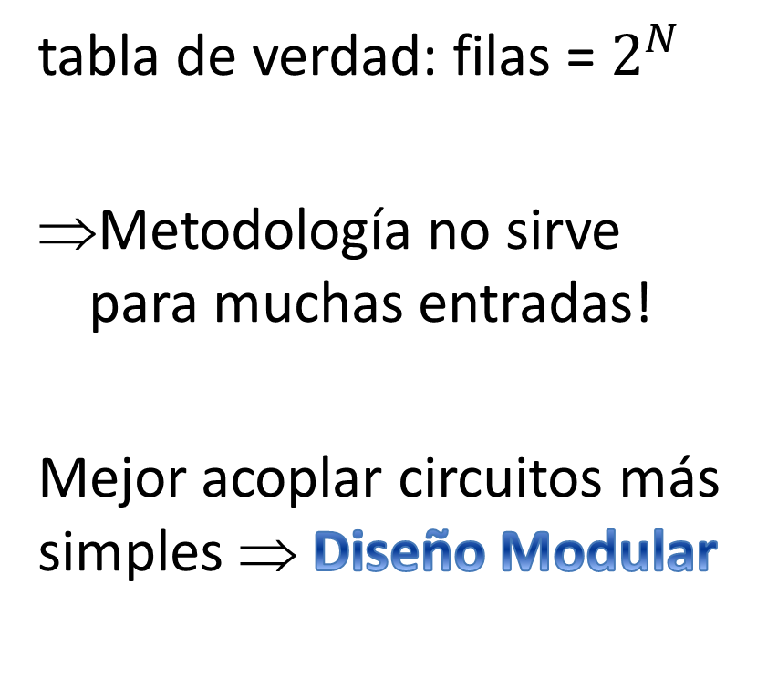

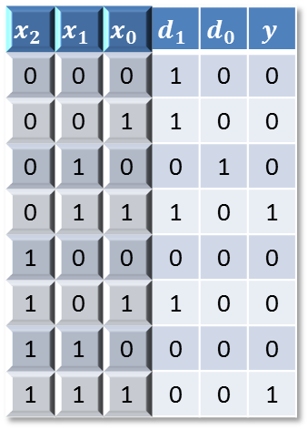
Motivación
tabla de verdad: filas = $2^{N}$
Metodología no sirve para muchas entradas!
Mejor acoplar circuitos más simples ⇒ Diseño Modular
$$x_{2}$$ | $$x_{1}$$ | $$x_{0}$$ | $$d_{1}$$ | $$d_{0}$$ | $$y$$
0 | 0 | 0 | 1 | 0 | 0
0 | 0 | 1 | 1 | 0 | 0
0 | 1 | 0 | 0 | 1 | 0
0 | 1 | 1 | 1 | 0 | 1
1 | 0 | 0 | 0 | 0 | 0
1 | 0 | 1 | 1 | 0 | 0
1 | 1 | 0 | 0 | 0 | 0
1 | 1 | 1 | 0 | 0 | 1
$$2^{N}$$

Slide 3
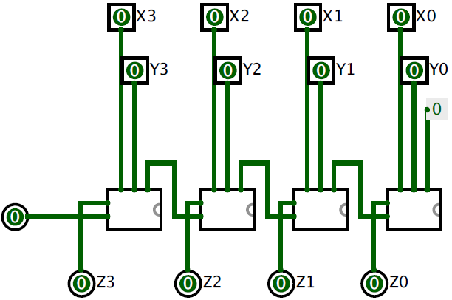
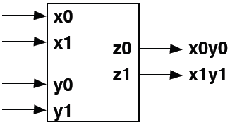
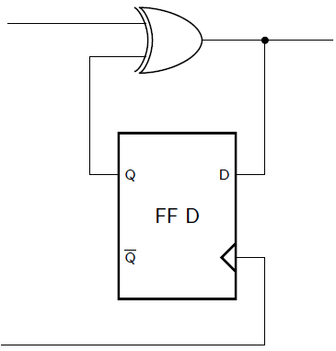
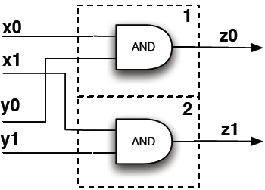
Estrategias
Paralelo
Cascada
Serial o Secuencial

Slide 4
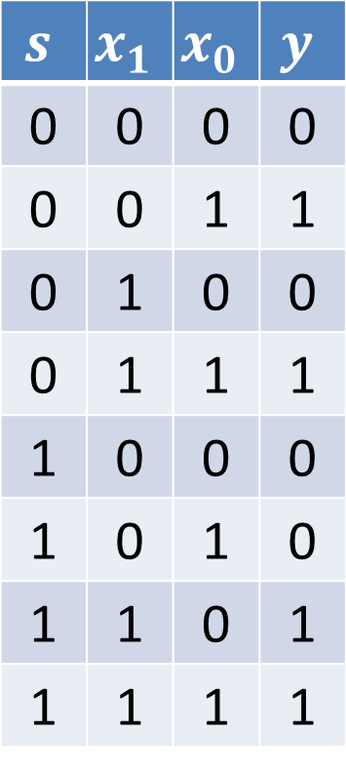

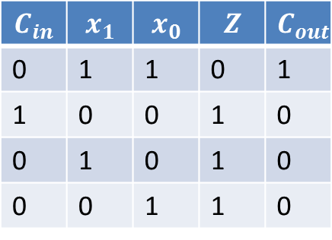

Multiplexor (Mux)
$$s$$ | $$x_{1}$$ | $$x_{0}$$ | $$y$$
0 | 0 | 0 | 0
0 | 0 | 1 | 1
0 | 1 | 0 | 0
0 | 1 | 1 | 1
1 | 0 | 0 | 0
1 | 0 | 1 | 0
1 | 1 | 0 | 1
1 | 1 | 1 | 1
$$y$$
$$\left\{x_{i}\right\}$$
Mux
$$\left\{s_{i}\right\}$$

Slide 5



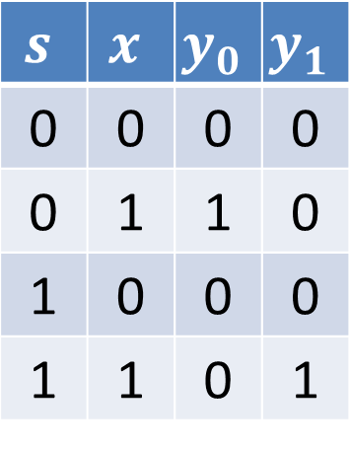
Demultiplexor (Demux)
$$s$$ | $$x$$ | $$y_{0}$$ | $$y_{1}$$
0 | 0 | 0 | 0
0 | 1 | 1 | 0
1 | 0 | 0 | 0
1 | 1 | 0 | 1
$$x$$
Demux
$$\left\{y_{i}\right\}$$
$$\left\{s_{i}\right\}$$

Slide 6
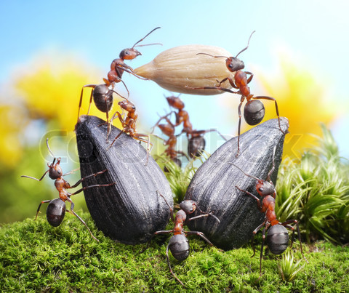
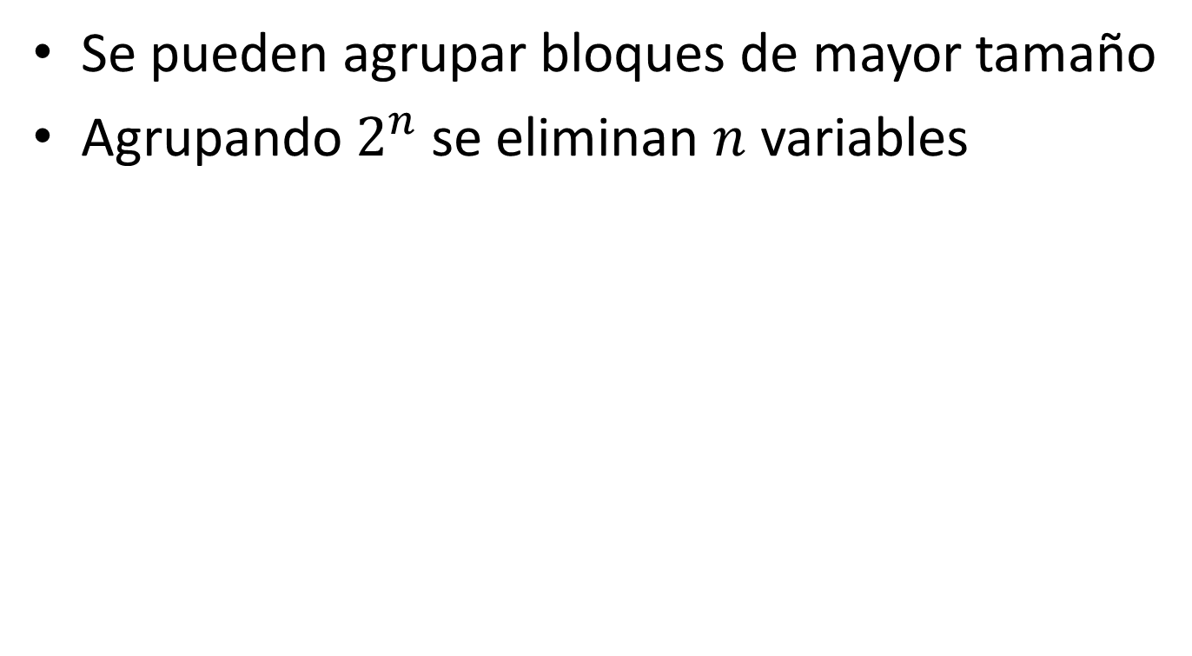

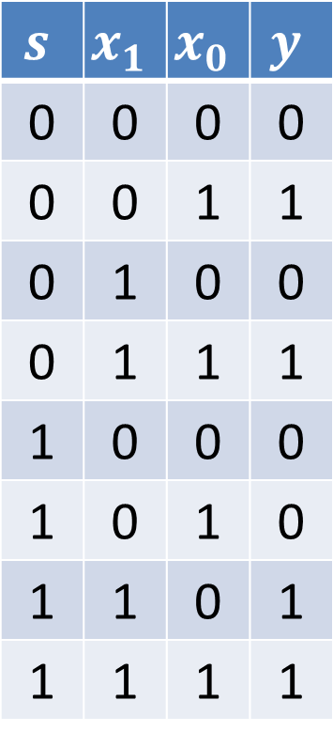
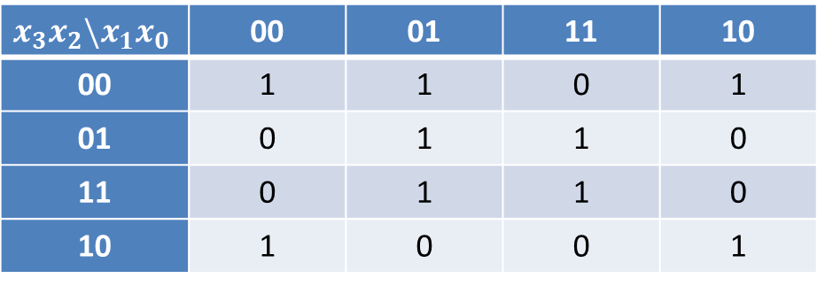



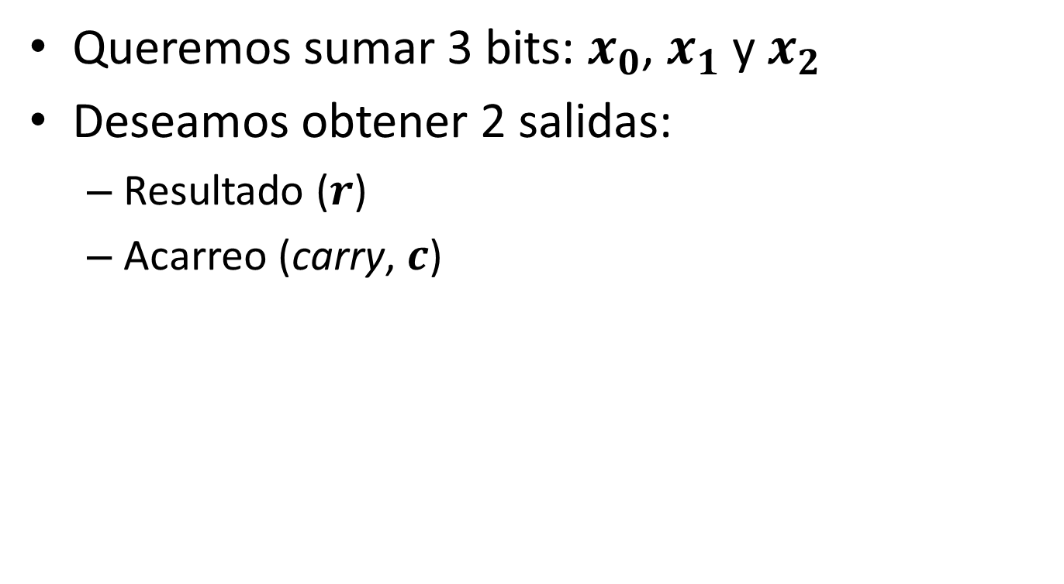

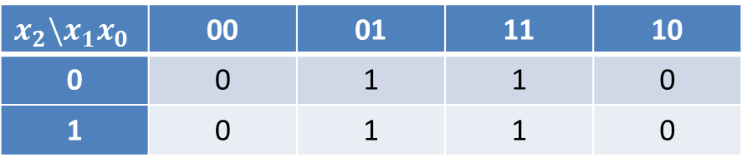
Trabajo Grupal 1
Recordar:
$$s$$ | $$x_{1}$$ | $$x_{0}$$ | $$y$$
0 | 0 | 0 | 0
0 | 0 | 1 | 1
0 | 1 | 0 | 0
0 | 1 | 1 | 1
1 | 0 | 0 | 0
1 | 0 | 1 | 0
1 | 1 | 0 | 1
1 | 1 | 1 | 1
$$x_{1}$$
$$y$$
OR
$$y$$
$$x_{2}$$
$$\left\{x_{i}\right\}$$
Mux
$$x_{1}$$
$$y$$
NOR
$$x_{2}$$
$$\left\{s_{i}\right\}$$
$$x_{1}$$
$$y$$
AND
$$x_{2}$$

Slide 7

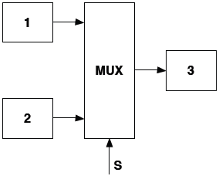
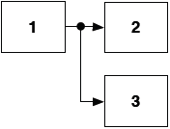

Estrategias de Comunicación
Punto a punto
1 a N
N a 1
Bus

Slide 8


Decodificador (Decoder)
$$x_{2}$$ | $$x_{1}$$ | $$x_{0}$$ | $$y_{7}$$ | $$y_{6}$$ | $$y_{5}$$ | $$y_{4}$$ | $$y_{3}$$ | $$y_{2}$$ | $$y_{1}$$ | $$y_{0}$$
0 | 0 | 0 | 0 | 0 | 0 | 0 | 0 | 0 | 0 | 1
0 | 0 | 1 | 0 | 0 | 0 | 0 | 0 | 0 | 1 | 0
0 | 1 | 0 | 0 | 0 | 0 | 0 | 0 | 1 | 0 | 0
0 | 1 | 1 | 0 | 0 | 0 | 0 | 1 | 0 | 0 | 0
1 | 0 | 0 | 0 | 0 | 0 | 1 | 0 | 0 | 0 | 0
1 | 0 | 1 | 0 | 0 | 1 | 0 | 0 | 0 | 0 | 0
1 | 1 | 0 | 0 | 1 | 0 | 0 | 0 | 0 | 0 | 0
1 | 1 | 1 | 1 | 0 | 0 | 0 | 0 | 0 | 0 | 0
$$\left\{y_{i}\right\}$$
Decoder
$$\left\{x_{i}\right\}$$

Slide 9
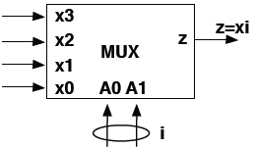
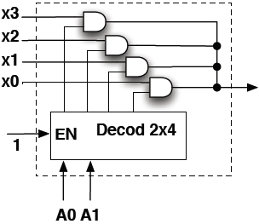
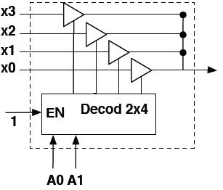
Implementación Multiplexor
Usando AND:
Usando compuertas tristate:

Slide 10

Codificador (Encoder)
$$x_{7}$$ | $$x_{6}$$ | $$x_{5}$$ | $$x_{4}$$ | $$x_{3}$$ | $$x_{2}$$ | $$x_{1}$$ | $$x_{0}$$ | $$y_{2}$$ | $$y_{1}$$ | $$y_{0}$$
0 | 0 | 0 | 0 | 0 | 0 | 0 | 0 | X | X | X
0 | 0 | 0 | 0 | 0 | 0 | 0 | 1 | 0 | 0 | 0
0 | 0 | 0 | 0 | 0 | 0 | 1 | X | 0 | 0 | 1
0 | 0 | 0 | 0 | 0 | 1 | X | X | 0 | 1 | 0
0 | 0 | 0 | 0 | 1 | X | X | X | 0 | 1 | 1
0 | 0 | 0 | 1 | X | X | X | X | 1 | 0 | 0
0 | 0 | 1 | X | X | X | X | X | 1 | 0 | 1
0 | 1 | X | X | X | X | X | X | 1 | 1 | 0
1 | X | X | X | X | X | X | X | 1 | 1 | 1
$$\left\{x_{i}\right\}$$
Encoder
$$\left\{y_{i}\right\}$$

Slide 11
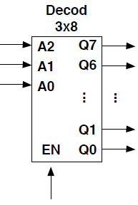
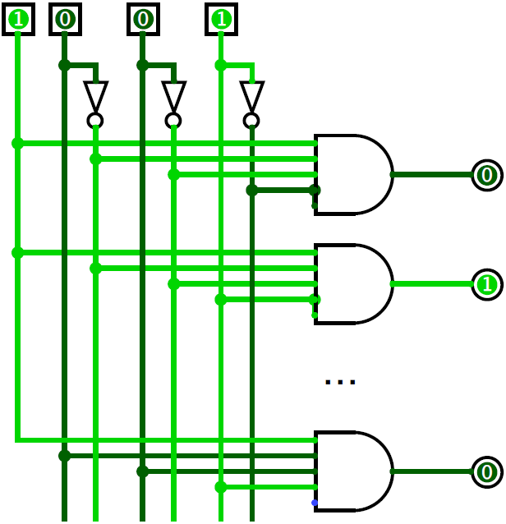
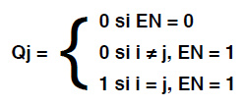
Implementación Decodificador
i=A2…A0

Slide 12
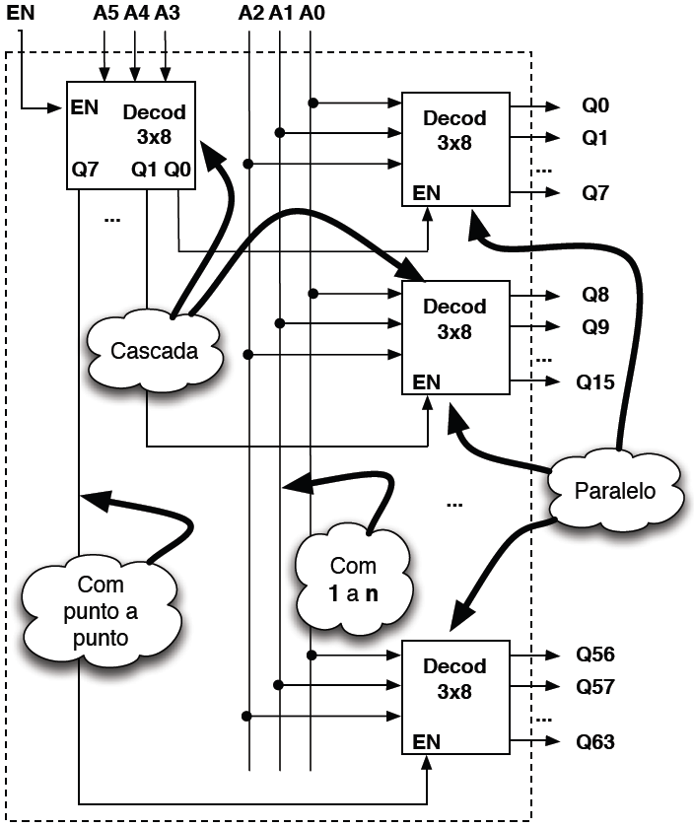
Decodificador 6x64
9 Decod 3x8 en cascada y/o paralelo

Slide 13
Trabajo Grupal 2

